Slide 1
Department of Information Technology Application Development Batch No: 19
TECHTRIX MANAGEMENT
D BHARATHCHANDRA - 20N31A1258
D VARUN KUMAR - 20N31A1250
B MOTILAL - 21N35A1201

Slide 2
Agenda
Abstract
Introduction
Existing System
Proposed System
System Requirements
References

Slide 3
Abstract
Techtrix is a fest conducted by Information Technology Department of Malla Reddy College of Engineering and Technology at the start of the every year. It has both technical and non-technical events in which students can participate to gain knowledge and test their abilities. It also consists of fun events to relax and enjoy themselves.
We aim to tell in this project how the fest was conducted, number of events, about each event in detail and the technical ways used in the event like registration forms used to participate in an event. Etc.

Slide 4
INTRODUCTION
Techtrix consists of both technical and non-technical events.
Technical events consists of
Poster presentation
Paper presentation
Codethon tech master
Mock interview
Idea pitching
Non-Technical events consists of
Vintage look
House of talents
Game on
Sixth sense
Haunted House is the special and most awaited event in the whole fest which is the main attraction of the fest in the college

Slide 5
Existing System
The Project “Techtrix Management” does not have any type of Existing system or Software.
Previously all the events, participating students lists, registration forms, other data regarding the Technical fest- “Techtrix” is being stored manually.
Managing and conducting these events through manual data is difficult for the respective co-ordinators.
Although there are few webpages for events, it is complex procedure for organisers, in collecting the data and organizing.
To overcome this, we are developing a website for automating these manual processes. So that all the information regarding Techtrix is available at one place.

Slide 6
Proposed System
In this Project, we would like to create a website for our Department’s Technical Fest – “Techtrix”.
We are proposing this website, so the complete information regarding the Techtrix is available at once.
Our proposed website contains all the list of events, respective co-ordinators, registration forms, venues, etc about the fest.
Our main objective is provide an easy and effective website for the fest which includes participation of many students of our department, and even other departments, colleges, etc.
We are developing this website with the help of HTML,CSS,PHP and JAVASCRIPT.

Slide 7
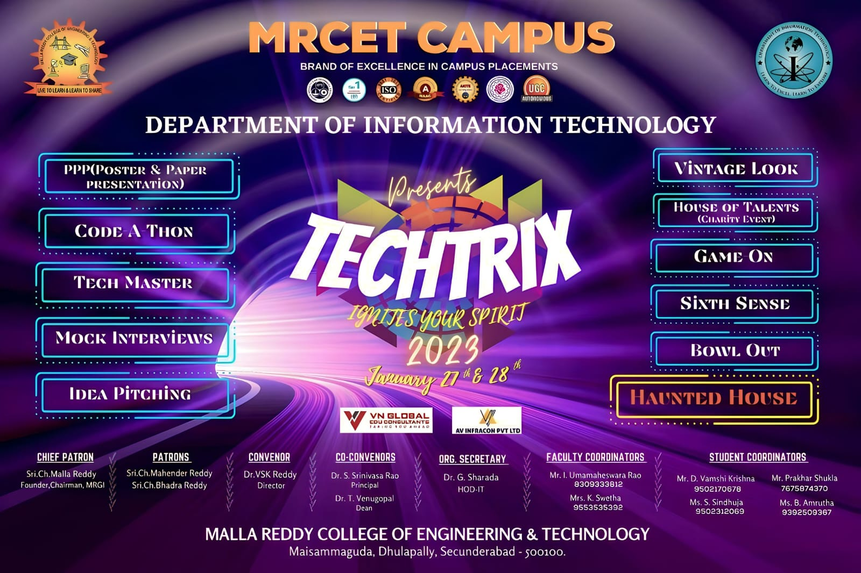

Slide 8
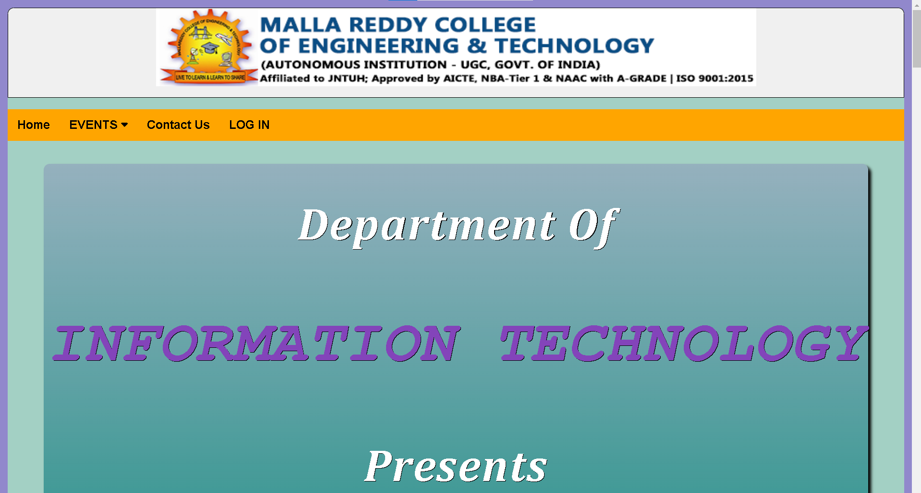
Techtrix Website

Slide 9
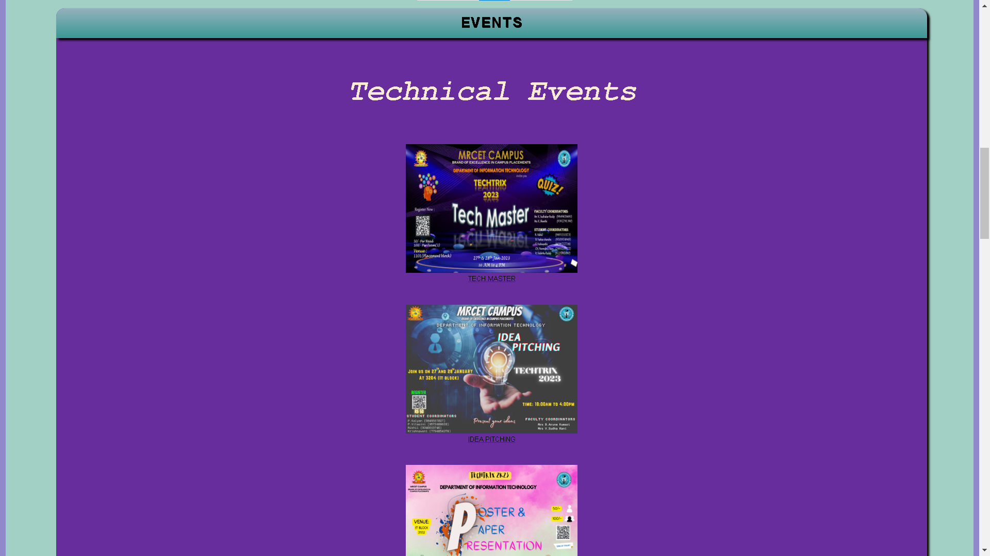
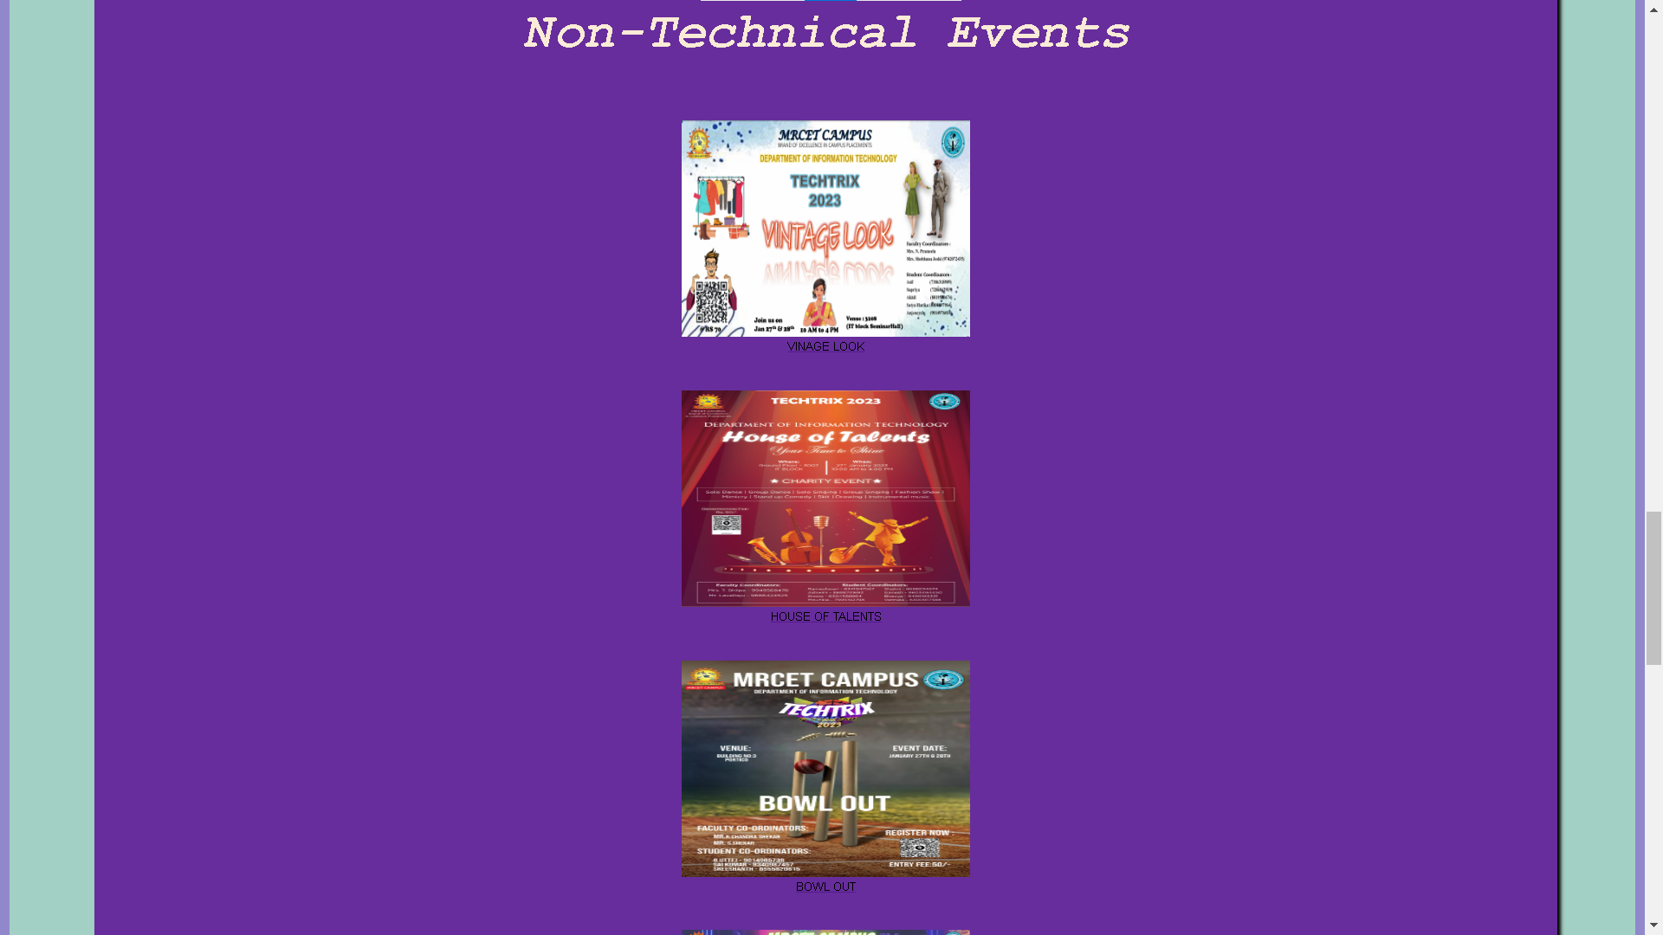

Slide 10
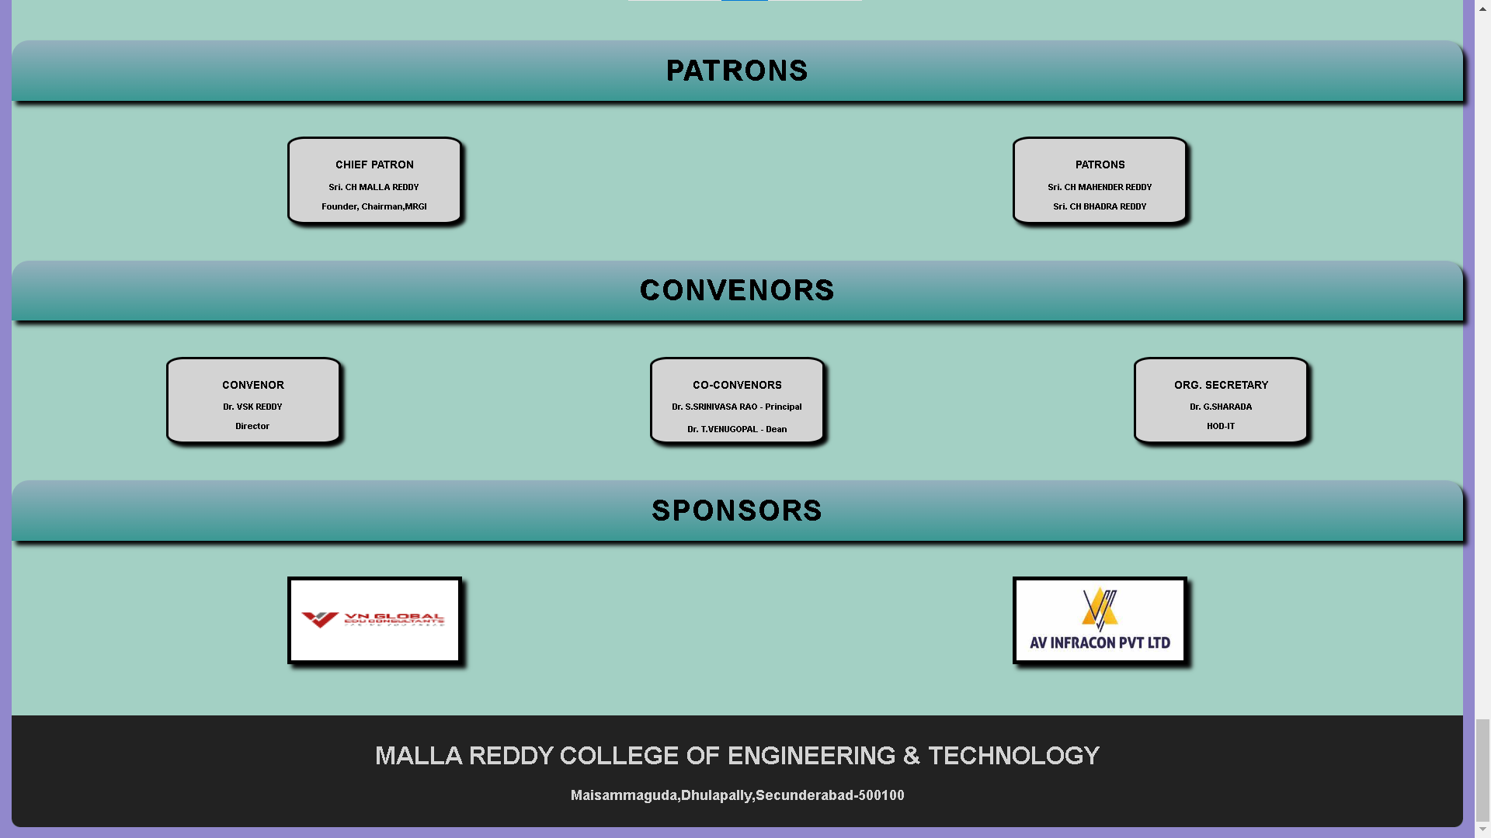

Slide 11
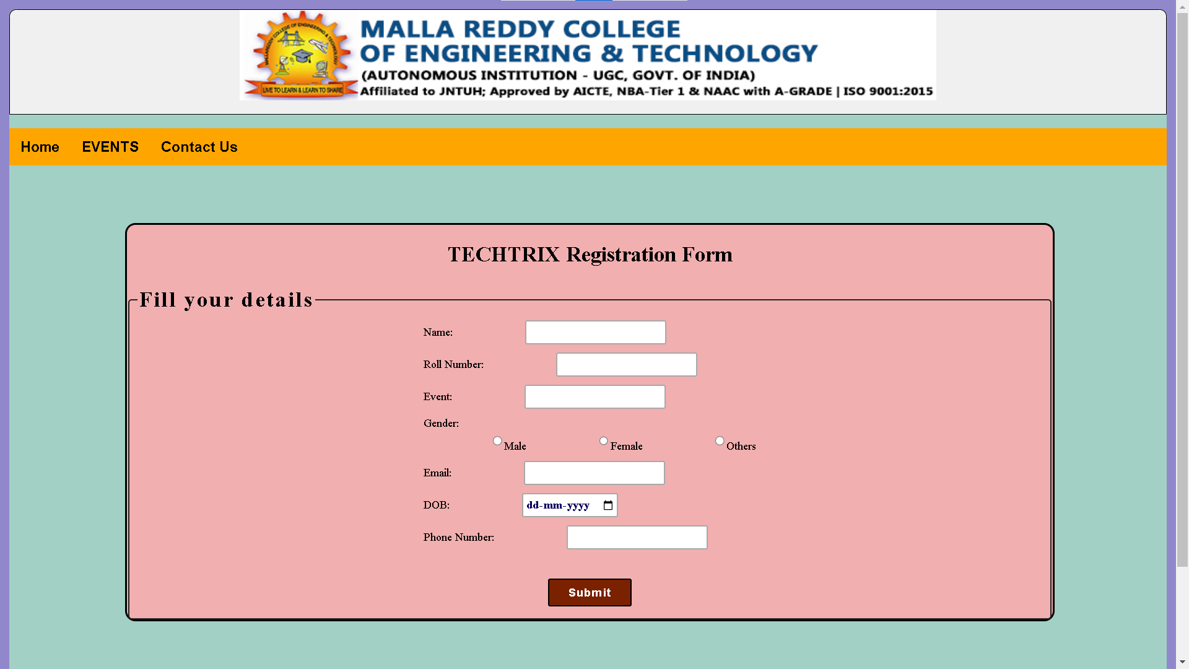

Slide 12
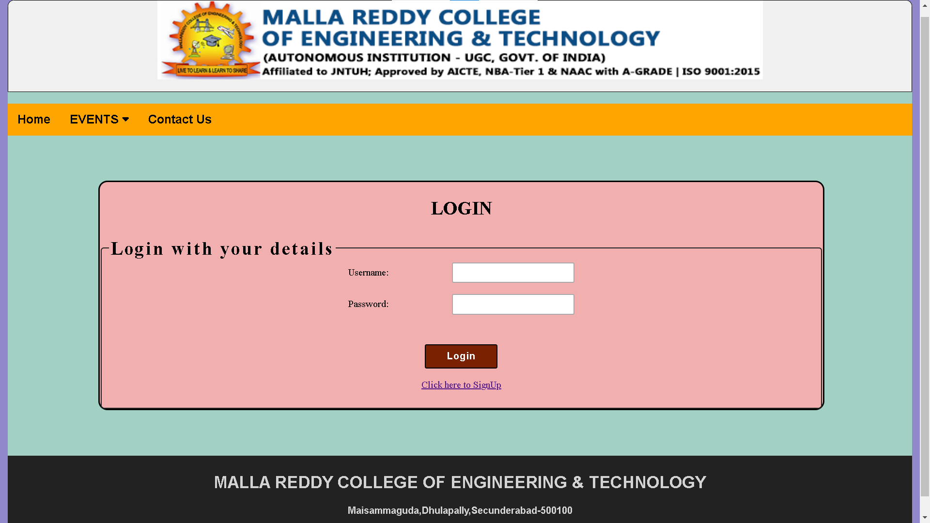

Slide 13
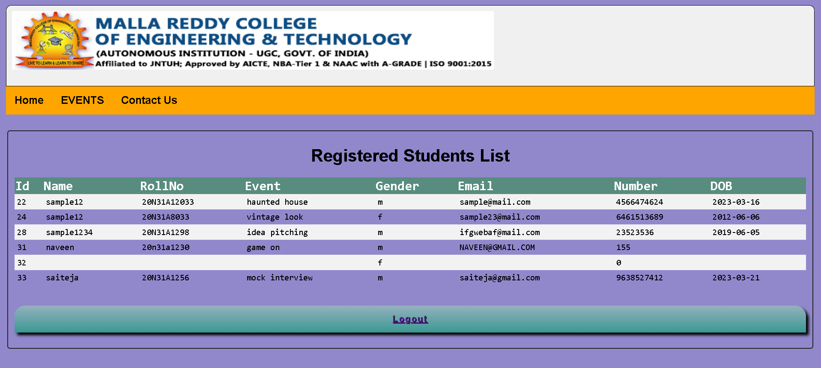

Slide 14
System Requirements
Hardware Requirements:
RAM: 8GB
Processor: Intel Core i5 or AMD Ryzen 5
A higher-capacity HDD such as 500 GB or 1 TB may be required.
Software Requirements:
Operating system: Windows, macOS and Linux
IDE’s: Visual Studio Code.
Database: Popular database management systems such as MySQL.
Programming languages: HTML, CSS

Slide 15
References
https://www.w3schools.com/html/
https://github.com/topics/html
https://www.geeksforgeeks.org/css/

Slide 16
THANK YOU

